Slide 1

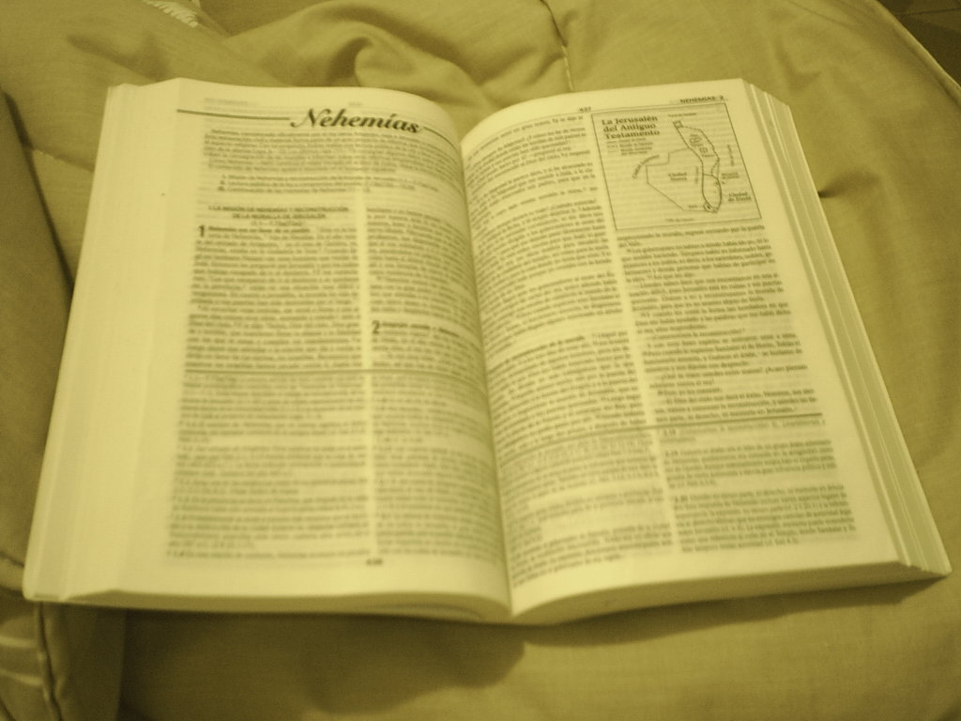
Comunicación y Gerencia
Accurately Handling The Word Of Truth
2 Timothy 2:15

Slide 2
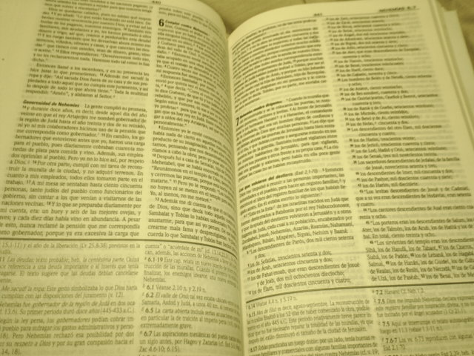
“Be diligent to present yourself approved to God as a workman who does not need to be ashamed, accurately handling the word of truth.”
(2 Timothy 2:15)

Slide 3
Give The Word Of God
A Fair Hearing

Slide 4
Study All The Bible Says On Any Given Subject.
1. Never form a conclusion until you examine all God says on that subject. Truth does not contradict itself.
2. For example:
John 3:16 –Some conclude the only thing necessary for salvation is an intellectual agreement (belief or acceptance) that Jesus Christ is the Son of God.
  a. However, John 12:42-43 illustrates believers who are lost.
  b. Faith that saves is described in James 2:14-26 as an obedient faith. Without works of obedience to God’s will, man will be lost. Luke 6:46; Matthew 7:21-23
Notes:
John 3:16 NKJV For God so loved the world that He gave His only begotten Son, that whoever believes in Him should not perish but have everlasting life.
John 12:42-43 Nevertheless many even of the rulers believed in Him, but because of the Pharisees they were not confessing Him, for fear that they would be put out of the synagogue; ⁴³ for they loved the approval of men rather than the approval of God..
James 2:14-26 What use is it, my brethren, if someone says he has faith but he has no works? Can that faith save him? ¹⁵ If a brother or sister is without clothing and in need of daily food, ¹⁶ and one of you says to them, “Go in peace, be warmed and be filled,” and yet you do not give them what is necessary for their body, what use is that? ¹⁷ Even so faith, if it has no works, is dead, being by itself.
¹⁸ But someone may well say, “You have faith and I have works; show me your faith without the works, and I will show you my faith by my works.” ¹⁹ You believe that God is one. You do well; the demons also believe, and shudder. ²⁰ But are you willing to recognize, you foolish fellow, that faith without works is useless? ²¹ Was not Abraham our father justified by works when he offered up Isaac his son on the altar? ²² You see that faith was working with his works, and as a result of the works, faith was perfected; ²³ and the Scripture was fulfilled which says, “And Abraham believed God, and it was reckoned to him as righteousness,” and he was called the friend of God. ²⁴ You see that a man is justified by works and not by faith alone. ²⁵ In the same way, was not Rahab the harlot also justified by works when she received the messengers and sent them out by another way? ²⁶ For just as the body without the spirit is dead, so also faith without works is dead.
Luke 6:46 ““Why do you call Me, ‘Lord, Lord,’ and do not do what I say?
Matthew 7:21-23 “Not everyone who says to Me, ‘Lord, Lord,’ will enter the kingdom of heaven, but he who does the will of My Father who is in heaven will enter. ²² Many will say to Me on that day, ‘Lord, Lord, did we not prophesy in Your name, and in Your name cast out demons, and in Your name perform many miracles?’ ²³ And then I will declare to them, ‘I never knew you; depart from Me, you who practice lawlessness.’

Slide 5
Do Not Study To Justify Yourself.
1. Some think it is an admission of weakness to say, “I was wrong.” Everyone should want to be right, but our motive for study should be to learn what is right and not just to prove we were never wrong!
2. Luke 16:14-15 —The Pharisees often questioned Jesus from this motive which caused them to pervert the truth.
3. 2 Corinthians 5:7 —We walk by faith, not sight.
Notes:
Luke 16:14-15 Now the Pharisees, who were lovers of money, were listening to all these things and were scoffing at Him. ¹⁵ And He said to them, “You are those who justify yourselves in the sight of men, but God knows your hearts; for that which is highly esteemed among men is detestable in the sight of God.
2 Corinthians 5:7 For we walk by faith, not by sight.

Slide 6
Accept The Scripture At Face Value

Slide 7
Let The Bible Mean What It Says.
1. God has revealed to us what we need to know and understand. Ephesians 3:3-5;
Deuteronomy 29:29
2. Some turn away from the simple truths of the Bible in search for deeper philosophies of men or for mystical ceremonies. 2 Corinthians 11:3-4; Colossians 2:6-8
3. False teachers often use the more difficult passages of the Bible to teach some theory. 2 Peter 3:14-16
Notes:
Ephesians 3:3-5 that by revelation there was made known to me the mystery, as I wrote before in brief. ⁴ By referring to this, when you read you can understand my insight into the mystery of Christ, ⁵ which in other generations was not made known to the sons of men, as it has now been revealed to His holy apostles and prophets in the Spirit;
Deuteronomy 29:29 “The secret things belong to the Lord our God, but the things revealed belong to us and to our sons forever, that we may observe all the words of this law.
2 Corinthians 11:3-4 But I am afraid that, as the serpent deceived Eve by his craftiness, your minds will be led astray from the simplicity and purity of devotion to Christ. ⁴ For if one comes and preaches another Jesus whom we have not preached, or you receive a different spirit which you have not received, or a different gospel which you have not accepted, you bear this beautifully.
Colossians 2:6-8 Therefore as you have received Christ Jesus the Lord, so walk in Him, ⁷ having been firmly rooted and now being built up in Him and established in your faith, just as you were instructed, and overflowing with gratitude.
⁸ See to it that no one takes you captive through philosophy and empty deception, according to the tradition of men, according to the elementary principles of the world, rather than according to Christ.
2 Peter 3:14-16 Therefore, beloved, since you look for these things, be diligent to be found by Him in peace, spotless and blameless, ¹⁵ and regard the patience of our Lord as salvation; just as also our beloved brother Paul, according to the wisdom given him, wrote to you, ¹⁶ as also in all his letters, speaking in them of these things, in which are some things hard to understand, which the untaught and unstable distort, as they do also the rest of the Scriptures, to their own destruction.

Slide 8
Do Not Let Prejudice Blind You.
1. If we “pre-judge,” making a decision without fair treatment of all the evidence, we will blind ourselves to truth. 2 Thessalonians 2:10-12
2. Some do not understand the Bible, but the fault is not God’s. Matthew 13:14-15
3. Do not let Satan blind you through unbelief.
“… in whose case the god of this world has blinded the minds of the unbelieving so that they might not see the light of the gospel of the glory of Christ, who is the image of God.”
(2 Corinthians 4:4)
Notes:
2 Thessalonians 2:10-12 and with all the deception of wickedness for those who perish, because they did not receive the love of the truth so as to be saved. ¹¹ For this reason God will send upon them a deluding influence so that they will believe what is false, ¹² in order that they all may be judged who did not believe the truth, but took pleasure in wickedness.
Matthew 13:14-15 In their case the prophecy of Isaiah is being fulfilled, which says, ‘You will keep on hearing, but will not understand; You will keep on seeing, but will not perceive; ¹⁵ For the heart of this people has become dull, With their ears they scarcely hear, And they have closed their eyes, Otherwise they would see with their eyes, Hear with their ears, And understand with their heart and return, And I would heal them.’
2 Corinthians 4:4 “…in whose case the god of this world has blinded the minds of the unbelieving so that they might not see the light of the gospel of the glory of Christ, who is the image of God.”

Slide 9
Let The Bible
Interpret Itself

Slide 10
Understand Difficult Passages
In The Light Of Clear Passages.
1. Some scriptures are more difficult. 2 Peter 3:16
2. For the mature Christian, the Bible has “meat,” but for the new babe in Christ there is “milk.” Hebrews 5:13-14
3. When studying a passage that seems confusing, be careful to harmonize it with other scriptures that clearly have but one meaning. Do not isolate scriptures in such a way as to form a contradiction, for God is not the author of confusion. 1 Corinthians 14:33
4. The most important attitude is the willingness to study for yourself. Acts 17:10-11; John 7:17;
1 Thessalonians 2:13
Notes:
2 Peter 3:16 ¹⁶ as also in all his letters, speaking in them of these things, in which are some things hard to understand, which the untaught and unstable distort, as they do also the rest of the Scriptures, to their own destruction.
Hebrews 5:13-14 For everyone who partakes only of milk is not accustomed to the word of righteousness, for he is an infant. ¹⁴ But solid food is for the mature, who because of practice have their senses trained to discern good and evil.
1 Corinthians 14:33 for God is not a God of confusion but of peace, as in all the churches of the saints.
Acts 17:10-11 The brethren immediately sent Paul and Silas away by night to Berea, and when they arrived, they went into the synagogue of the Jews. Now these were more noble-minded than those in Thessalonica, for they received the word with great eagerness, examining the Scriptures daily to see whether these things were so.
John 7:17 If anyone is willing to do His will, he will know of the teaching, whether it is of God or whether I speak from Myself.
1 Thessalonians 2:13 For this reason we also constantly thank God that when you received the word of God which you heard from us, you accepted it not as the word of men, but for what it really is, the word of God, which also performs its work in you who believe.

Slide 11
Do Not Worship
The “Idols” Of The Devil.
1. Idol Of Personal Opinion: “I know the Bible says … but here’s what I think …”
Those who are “proud in the thoughts of their heart” reject God, Luke 1:51; Jeremiah 9:3-6, 13-16;
Isaiah 55:8-9; Psalm 14:1.
2. Idol of Wisdom: “The ‘reverend’ Doctor So&So said this … he is highly educated and should know.”
His worldly wisdom might have blinded him.
1 Corinthians 1:18-25
3. Idol of Ecclesiasticism: “Our church teaches …”
The religious leaders rejected Christ. Would you have followed them? 1 Corinthians 2:7-8; 2 Timothy 4:2-4; Jeremiah 10:23.
Notes:
Luke 1:51 “He has done mighty deeds with His arm; He has scattered those who were proud in the thoughts of their heart.
Jeremiah 9:3-6 “They bend their tongue like their bow; Lies and not truth prevail in the land; For they proceed from evil to evil, And they do not know Me,” declares the Lord. ⁴ “Let everyone be on guard against his neighbor, And do not trust any brother; Because every brother deals craftily, And every neighbor goes about as a slanderer. ⁵ “Everyone deceives his neighbor And does not speak the truth, They have taught their tongue to speak lies; They weary themselves committing iniquity. ⁶ “Your dwelling is in the midst of deceit; Through deceit they refuse to know Me,” declares the Lord.
Jeremiah 9:13-16 The Lord said, “Because they have forsaken My law which I set before them, and have not obeyed My voice nor walked according to it, ¹⁴ but have walked after the stubbornness of their heart and after the Baals, as their fathers taught them,” ¹⁵ therefore thus says the Lord of hosts, the God of Israel, “behold, I will feed them, this people, with wormwood and give them poisoned water to drink. ¹⁶ I will scatter them among the nations, whom neither they nor their fathers have known; and I will send the sword after them until I have annihilated them.”
Isaiah 55:8-9 “For My thoughts are not your thoughts, Nor are your ways My ways,” declares the Lord. ⁹ “For as the heavens are higher than the earth, So are My ways higher than your ways And My thoughts than your thoughts.
Psalm 14:1 The fool has said in his heart, “There is no God.” They are corrupt, they have committed abominable deeds; There is no one who does good.
1 Corinthians 1:18-25 For the word of the cross is foolishness to those who are perishing, but to us who are being saved it is the power of God. ¹⁹ For it is written, “I will destroy the wisdom of the wise, And the cleverness of the clever I will set aside.” ²⁰ Where is the wise man? Where is the scribe? Where is the debater of this age? Has not God made foolish the wisdom of the world? ²¹ For since in the wisdom of God the world through its wisdom did not come to know God, God was well-pleased through the foolishness of the message preached to save those who believe. ²² For indeed Jews ask for signs and Greeks search for wisdom; ²³ but we preach Christ crucified, to Jews a stumbling block and to Gentiles foolishness, ²⁴ but to those who are the called, both Jews and Greeks, Christ the power of God and the wisdom of God. ²⁵ Because the foolishness of God is wiser than men, and the weakness of God is stronger than men.
1 Corinthians 2:7-8 but we speak God’s wisdom in a mystery, the hidden wisdom which God predestined before the ages to our glory; ⁸ the wisdom which none of the rulers of this age has understood; for if they had understood it they would not have crucified the Lord of glory;
2 Timothy 4:2-4 preach the word; be ready in season and out of season; reprove, rebuke, exhort, with great patience and instruction. ³ For the time will come when they will not endure sound doctrine; but wanting to have their ears tickled, they will accumulate for themselves teachers in accordance to their own desires, ⁴ and will turn away their ears from the truth and will turn aside to myths.
Jeremiah 10:23 I know, O Lord, that a man’s way is not in himself, Nor is it in a man who walks to direct his steps.

Slide 12
Do Not Worship
The “Idols” Of The Devil.
4. Idol of Human Creeds: “The catechism says thus and so …” OR, “My pastor says …” OR “My priest says …”
Doctrines of men are the source of religious division. Matthew 15:7-9; Proverbs 14:12
5. Idol of Inherited Traditions: “My parents believed …
and if it was good enough for them, it is good enough for me.” Romans 14:12; Matthew 10:34-38. Paul left everything. Philippians 3:3-8
6. Idol of Convenience: “Believe what you want … we are all headed to the same place. Matthew 7:21-23
7. Idol of Popularity: “The majority believe this … surely so many could not be wrong.” Matthew 7:13-14
Notes:
Matthew 15:7-9 You hypocrites, rightly did Isaiah prophesy of you: ⁸ ‘This people honors Me with their lips, But their heart is far away from Me. ⁹ ‘But in vain do they worship Me, Teaching as doctrines the precepts of men.’”
Proverbs 14:12 There is a way which seems right to a man, But its end is the way of death.
Romans 14:12 So then each one of us will give an account of himself to God.
Matthew 10:34-38 “Do not think that I came to bring peace on the earth; I did not come to bring peace, but a sword. ³⁵ For I came to set a man against his father, and a daughter against her mother, and a daughter-in-law against her mother-in-law; ³⁶ and a man’s enemies will be the members of his household. ³⁷ “He who loves father or mother more than Me is not worthy of Me; and he who loves son or daughter more than Me is not worthy of Me. ³⁸ And he who does not take his cross and follow after Me is not worthy of Me.
Philippians 3:3-8 for we are the true circumcision, who worship in the Spirit of God and glory in Christ Jesus and put no confidence in the flesh, ⁴ although I myself might have confidence even in the flesh. If anyone else has a mind to put confidence in the flesh, I far more: ⁵ circumcised the eighth day, of the nation of Israel, of the tribe of Benjamin, a Hebrew of Hebrews; as to the Law, a Pharisee; ⁶ as to zeal, a persecutor of the church; as to the righteousness which is in the Law, found blameless.
⁷ But whatever things were gain to me, those things I have counted as loss for the sake of Christ. ⁸ More than that, I count all things to be loss in view of the surpassing value of knowing Christ Jesus my Lord, for whom I have suffered the loss of all things, and count them but rubbish so that I may gain Christ,
Matthew 7:21-23 “Not everyone who says to Me, ‘Lord, Lord,’ will enter the kingdom of heaven, but he who does the will of My Father who is in heaven will enter. ²² Many will say to Me on that day, ‘Lord, Lord, did we not prophesy in Your name, and in Your name cast out demons, and in Your name perform many miracles?’ ²³ And then I will declare to them, ‘I never knew you; depart from Me, you who practice lawlessness.’
Mathew 7:13-14 “Enter through the narrow gate; for the gate is wide and the way is broad that leads to destruction, and there are many who enter through it. ¹⁴ For the gate is small and the way is narrow that leads to life, and there are few who find it.

Slide 13
Properly Evaluate The Importance Of Truth

Slide 14
Buy Truth and Do Not Sell It.
1. Give up anything for the sake of truth, and once you have learned and obeyed it, refuse to part with it for any price. Proverbs 23:23;
Matthew 13:45-46
2. A desire for truth above all else will be rewarded. Matthew 5:6
3. Handle the truth with respect, reverence, and obedience. Romans 6:17-18
Notes:
Proverbs 23:23 Buy truth, and do not sell it, Get wisdom and instruction and understanding.
Matthew 13:45-46 “Again, the kingdom of heaven is like a merchant seeking fine pearls, ⁴⁶ and upon finding one pearl of great value, he went and sold all that he had and bought it.
Mathew 5:6 Blessed are those who hunger and thirst for righteousness, for they shall be satisfied.
Romans 6:17-18 But thanks be to God that though you were slaves of sin, you became obedient from the heart to that form of teaching to which you were committed, ¹⁸ and having been freed from sin, you became slaves of righteousness.

Slide 15
Where to find Truth?
“Sanctify them in the truth;
Your word is truth.” John 17:17
“The sum of Your word is truth, And every one of Your righteous ordinances is everlasting.” Psalm 119:160
“Jesus said to him, “I am the way, and the truth, and the life; no one comes to the Father but through Me.” John 14:6

Slide 16
Do Not Presume God Will Accept Anything Else.
1. Presumptuous sins are those which overstep the proper bounds of God’s word, assuming that God will accept our will. Leviticus 10:1-2; Psalm 19:13-14
  a. God has always required more than “good intentions.” 1 Samuel 15:22-23
2. The apostles taught that whether or not we accept God’s Will without alteration makes a difference to Him. Galatians 1:6-9; 2 John 9
Notes:
Leviticus 10:1-2 Now Nadab and Abihu, the sons of Aaron, took their respective firepans, and after putting fire in them, placed incense on it and offered strange fire before the Lord, which He had not commanded them. ² And fire came out from the presence of the Lord and consumed them, and they died before the Lord.
Psalm 19:13-14 Also keep back Your servant from presumptuous sins; Let them not rule over me; Then I will be blameless, And I shall be acquitted of great transgression. ¹⁴ Let the words of my mouth and the meditation of my heart Be acceptable in Your sight, O Lord, my rock and my Redeemer.
1 Samuel 15:22-23 Samuel said, “Has the Lord as much delight in burnt offerings and sacrifices As in obeying the voice of the Lord? Behold, to obey is better than sacrifice, And to heed than the fat of rams. ²³ “For rebellion is as the sin of divination,
And insubordination is as iniquity and idolatry. Because you have rejected the word of the Lord, He has also rejected you from being king.”
Galatians 1:6-9 I am amazed that you are so quickly deserting Him who called you by the grace of Christ, for a different gospel; ⁷ which is really not another; only there are some who are disturbing you and want to distort the gospel of Christ. ⁸ But even if we, or an angel from heaven, should preach to you a gospel contrary to what we have preached to you, he is to be accursed! ⁹ As we have said before, so I say again now, if any man is preaching to you a gospel contrary to what you received, he is to be accursed!
2 John 9 Anyone who goes too far and does not abide in the teaching of Christ, does not have God; the one who abides in the teaching, he has both the Father and the Son.

Slide 17
Do Not Presume God Will Accept Anything Else.
3. “Adding to” or “taking from” God’s word brings a curse. Revelation 22:18-19
4. Remember that His word is everlasting, unchangeable, and the standard by which we will be judged. 1 Peter 1:23-25; John 12:48
“Heaven and earth will pass away, but My words will not pass away.”
(Matthew 24:35)
Notes:
Revelation 22:18-19 I testify to everyone who hears the words of the prophecy of this book: if anyone adds to them, God will add to him the plagues which are written in this book; ¹⁹ and if anyone takes away from the words of the book of this prophecy, God will take away his part from the tree of life and from the holy city, which are written in this book.
1 Peter 1:23-25 for you have been born again not of seed which is perishable but imperishable, that is, through the living and enduring word of God. ²⁴ For, “All flesh is like grass, And all its glory like the flower of grass. The grass withers, And the flower falls off, ²⁵ But the word of the Lord endures forever.” And this is the word which was preached to you.
John 12 48 He who rejects Me and does not receive My sayings, has one who judges him; the word I spoke is what will judge him at the last day.

Slide 18
Comunicación y Gerencia
Accurately Handling The Word Of Truth
2 Timothy 2:15

Slide 19
Why Don’t All Obey It?
Answer:
God has assured us that when His word is preached that it will not return unto Him empty. Isaiah 55:10-11
If it does not save all men, it is not because God does not will it so. 1 Timothy 2:4; 2 Peter 3:9
The trouble is … some will not come to God!
“… and you are unwilling to come to me, so that you may have life.” (John 5:40)
Notes:
Isaiah 55:10-11 “For as the rain and the snow come down from heaven, And do not return there without watering the earth And making it bear and sprout, And furnishing seed to the sower and bread to the eater; ¹¹ So will My word be which goes forth from My mouth; It will not return to Me empty, Without accomplishing what I desire, And without succeeding in the matter for which I sent it.
1 Timothy 2:3-4 This is good and acceptable in the sight of God our Savior, ⁴ who desires all men to be saved and to come to the knowledge of the truth.
2 Peter 3:9 The Lord is not slow about His promise, as some count slowness, but is patient toward you, not wishing for any to perish but for all to come to repentance.
John 5:39-40 You search the Scriptures because you think that in them you have eternal life; it is these that testify about Me; ⁴⁰ and you are unwilling to come to Me so that you may have life.

Slide 20
Conclusion:
If you are not a Christian, you must …
  Hear the gospel, Romans 10:17
  Believe the gospel, Mark 16:15-16
  Repent of sins, Acts 2:36-38
  Confess faith in Jesus, Acts 8:36-37
  Be Baptized, Acts 22:16; Galatians 3:26-27
Obey the gospel “for it is the power of God for salvation” Romans 1:16-17;
2 Thessalonians 1:6-9; 1 Peter 4:17
Notes:
Romans 10:17 So faith comes from hearing, and hearing by the word of Christ.
Mark 16:15-16 And He said to them, “Go into all the world and preach the gospel to all creation. ¹⁶ He who has believed and has been baptized shall be saved; but he who has disbelieved shall be condemned.
Acts 2:36-38 Therefore let all the house of Israel know for certain that God has made Him both Lord and Christ—this Jesus whom you crucified.” ³⁷ Now when they heard this, they were pierced to the heart, and said to Peter and the rest of the apostles, “Brethren, what shall we do?” ³⁸ Peter said to them, “Repent, and each of you be baptized in the name of Jesus Christ for the forgiveness of your sins; and you will receive the gift of the Holy Spirit.
Acts 8:36-37 As they went along the road they came to some water; and the eunuch *said, “Look! Water! What prevents me from being baptized?” ³⁷ [And Philip said, “If you believe with all your heart, you may.” And he answered and said, “I believe that Jesus Christ is the Son of God.”]
Acts 22:16 Now why do you delay? Get up and be baptized, and wash away your sins, calling on His name.’
Galatians 3:26-27 For you are all sons of God through faith in Christ Jesus. ²⁷ For all of you who were baptized into Christ have clothed yourselves with Christ.
Romans 1:16-17 For I am not ashamed of the gospel, for it is the power of God for salvation to everyone who believes, to the Jew first and also to the Greek. ¹⁷ For in it the righteousness of God is revealed from faith to faith; as it is written, “But the righteous man shall live by faith.”
2 Thessalonians 1:6-9 For after all it is only just for God to repay with affliction those who afflict you, ⁷ and to give relief to you who are afflicted and to us as well when the Lord Jesus will be revealed from heaven with His mighty angels in flaming fire, ⁸ dealing out retribution to those who do not know God and to those who do not obey the gospel of our Lord Jesus. ⁹ These will pay the penalty of eternal destruction, away from the presence of the Lord and from the glory of His power,
1 Peter 4:17 For it is time for judgment to begin with the household of God; and if it begins with us first, what will be the outcome for those who do not obey the gospel of God?

Slide 21
Conclusion:
If you are a Christian, you must …
  Hold fast the word. 1 Corinthians 15:1-2
  Not fall away. Hebrews 3:12-14
  Remain faithful. Revelation 2:10b
  Not forsake the assembly but encourage one another. Hebrews 10:23-25
  Be dead to sin and alive to God. Romans 6:1-13
… Continue to grow in the faith.
  1 Peter 2:2; 2 Peter 1: 5-11; 2 Peter 3:18
Notes:
1 Corinthians 1-2 Now I make known to you, brethren, the gospel which I preached to you, which also you received, in which also you stand, ² by which also you are saved, if you hold fast the word which I preached to you, unless you believed in vain.
Hebrews 3:12-14 Take care, brethren, that there not be in any one of you an evil, unbelieving heart that falls away from the living God. ¹³ But encourage one another day after day, as long as it is still called “Today,” so that none of you will be hardened by the deceitfulness of sin. ¹⁴ For we have become partakers of Christ, if we hold fast the beginning of our assurance firm until the end…
Revelation 2:10b Be faithful until death, and I will give you the crown of life.
Hebrews 10: 23-25 Let us hold fast the confession of our hope without wavering, for He who promised is faithful; ²⁴ and let us consider how to stimulate one another to love and good deeds, ²⁵ not forsaking our own assembling together, as is the habit of some, but encouraging one another; and all the more as you see the day drawing near.
Romans 6:1-12 What shall we say then? Are we to continue in sin so that grace may increase? ² May it never be! How shall we who died to sin still live in it? ³ Or do you not know that all of us who have been baptized into Christ Jesus have been baptized into His death? ⁴ Therefore we have been buried with Him through baptism into death, so that as Christ was raised from the dead through the glory of the Father, so we too might walk in newness of life. ⁵ For if we have become united with Him in the likeness of His death, certainly we shall also be in the likeness of His resurrection, ⁶ knowing this, that our old self was crucified with Him, in order that our body of sin might be done away with, so that we would no longer be slaves to sin; ⁷ for he who has died is freed from sin.
⁸ Now if we have died with Christ, we believe that we shall also live with Him, ⁹ knowing that Christ, having been raised from the dead, is never to die again; death no longer is master over Him. ¹⁰ For the death that He died, He died to sin once for all; but the life that He lives, He lives to God. ¹¹ Even so consider yourselves to be dead to sin, but alive to God in Christ Jesus. ¹² Therefore do not let sin reign in your mortal body so that you obey its lusts, ¹³ and do not go on presenting the members of your body to sin as instruments of unrighteousness; but present yourselves to God as those alive from the dead, and your members as instruments of righteousness to God.
1 Peter 2:2 like newborn babies, long for the pure milk of the word, so that by it you may grow in respect to salvation,
2 Peter 1: 5-11 ⁵ Now for this very reason also, applying all diligence, in your faith supply moral excellence, and in your moral excellence, knowledge, ⁶ and in your knowledge, self-control, and in your self-control, perseverance, and in your perseverance, godliness, ⁷ and in your godliness, brotherly kindness, and in your brotherly kindness, love. ⁸ For if these qualities are yours and are increasing, they render you neither useless nor unfruitful in the true knowledge of our Lord Jesus Christ. ⁹ For he who lacks these qualities is blind or short-sighted, having forgotten his purification from his former sins. ¹⁰ Therefore, brethren, be all the more diligent to make certain about His calling and choosing you; for as long as you practice these things, you will never stumble; ¹¹ for in this way the entrance into the eternal kingdom of our Lord and Savior Jesus Christ will be abundantly supplied to you.
2 Peter 3:18 ¹⁸ but grow in the grace and knowledge of our Lord and Savior Jesus Christ. To Him be the glory, both now and to the day of eternity. Amen.

